Slide 1
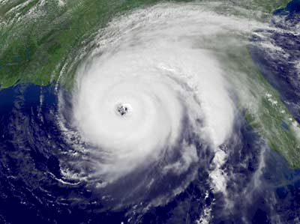
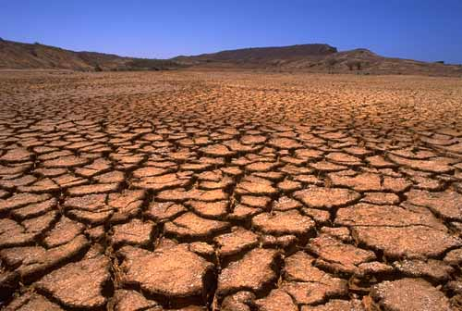
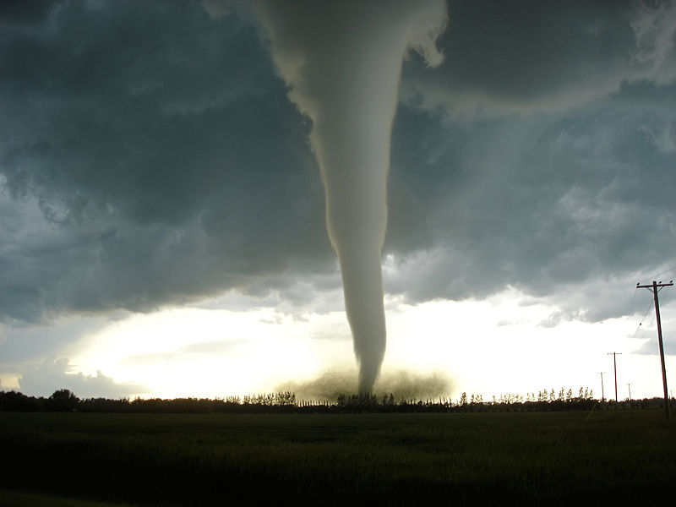
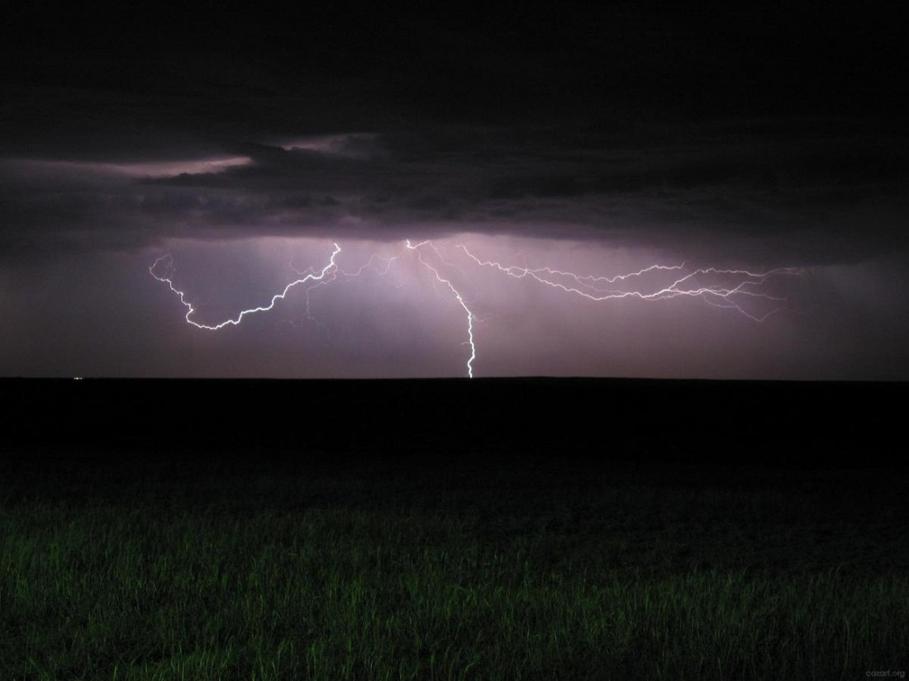
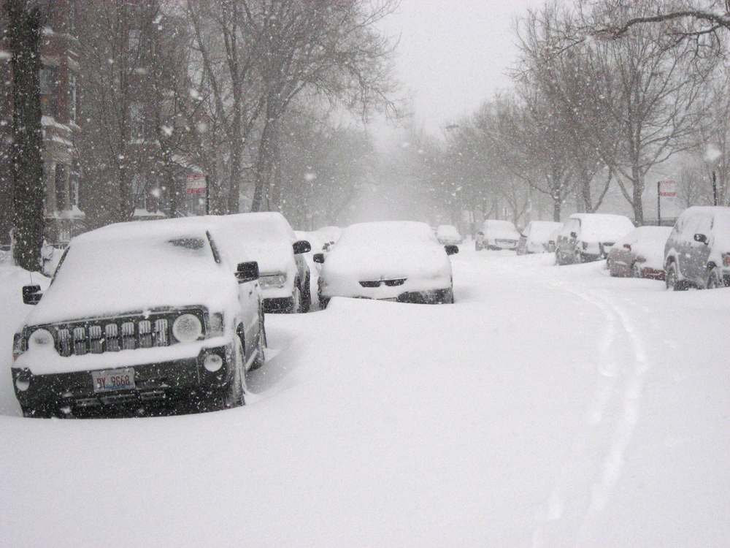
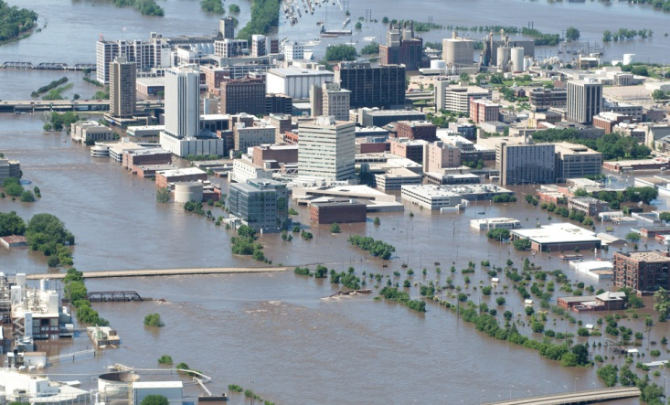
Severe Weather

Slide 2
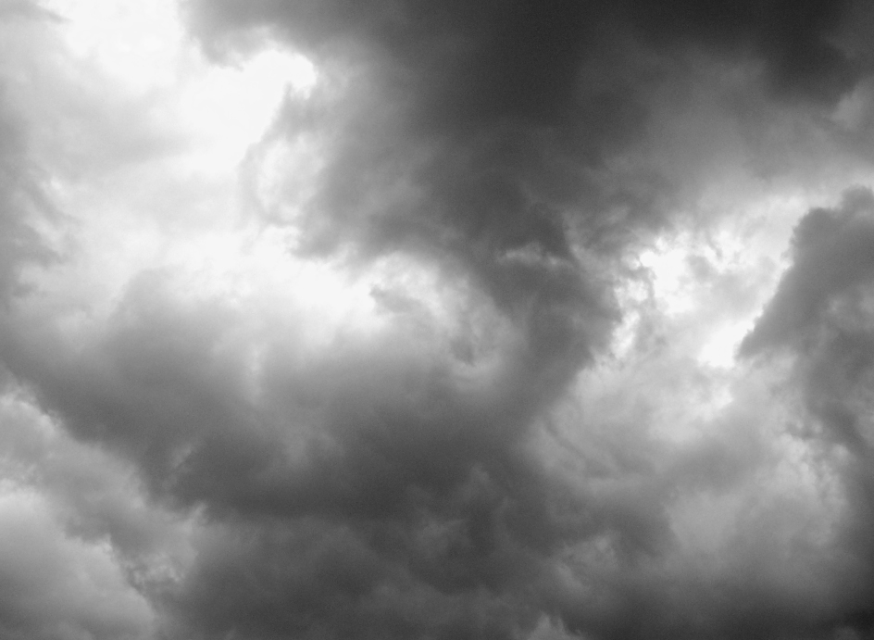
Severe Weather
Hurricanes
Tornadoes
Thunder & Lightning Storms
Blizzards
Floods
Droughts

Slide 3
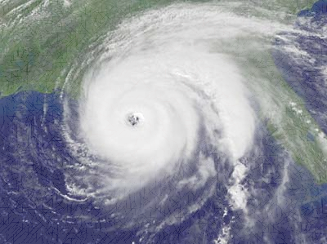
Hurricanes
What is a hurricane?
A hurricane is a huge rotating storm. It forms in warm ocean water. They produce strong winds, heavy rain and large waves, powerful waves.
Hurricane season in the Atlantic Ocean runs from June 1 to November 30.
Other names for hurricanes: typhoons and cyclones

Slide 4
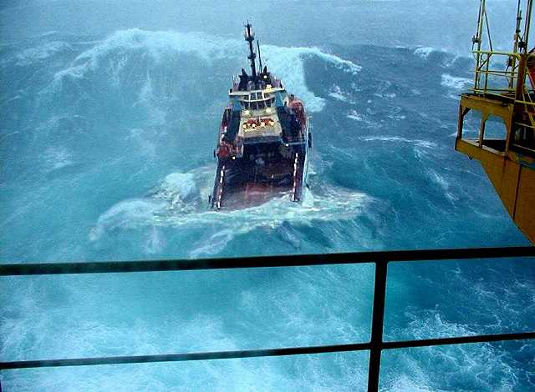

Slide 5
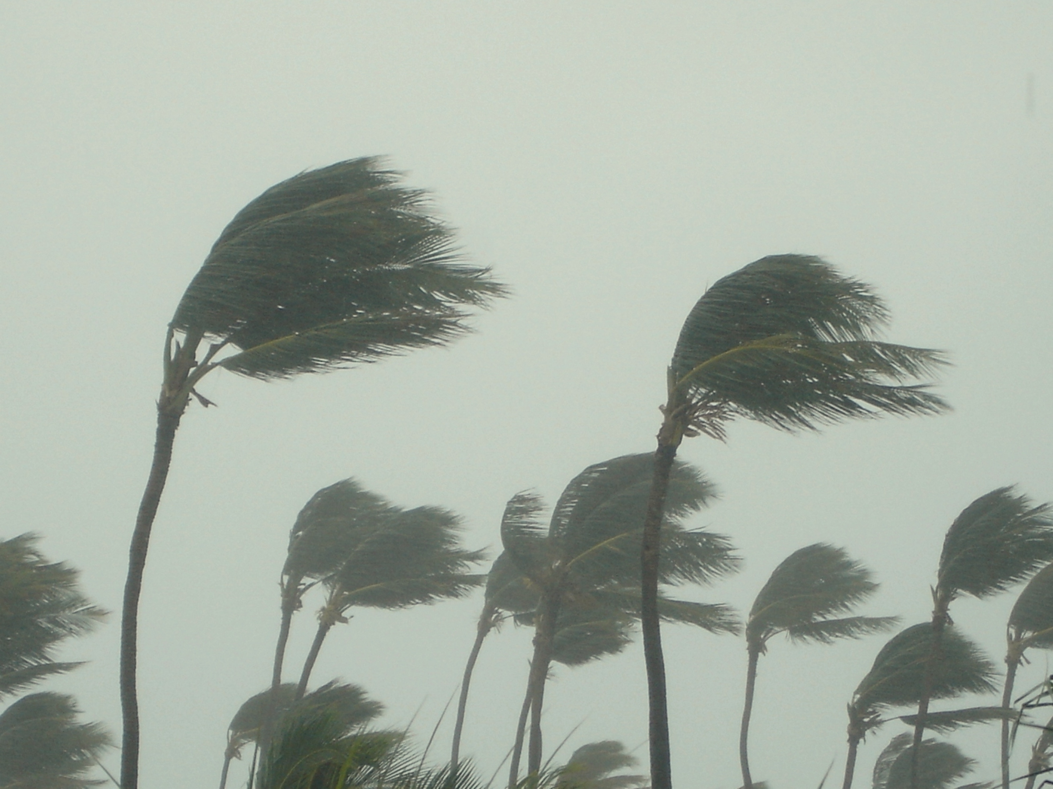

Slide 6
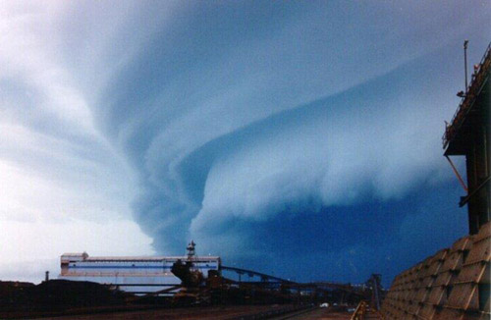

Slide 7
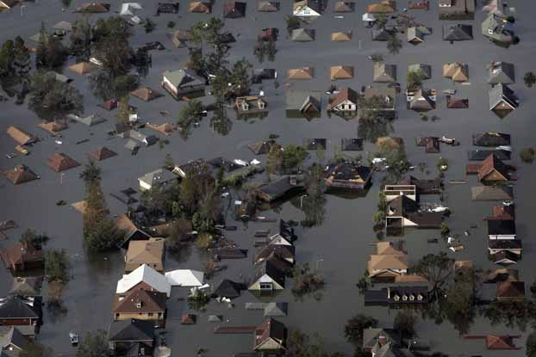

Slide 8
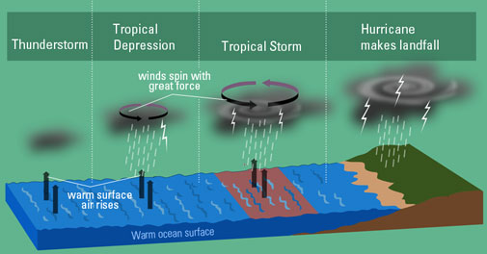

Slide 9
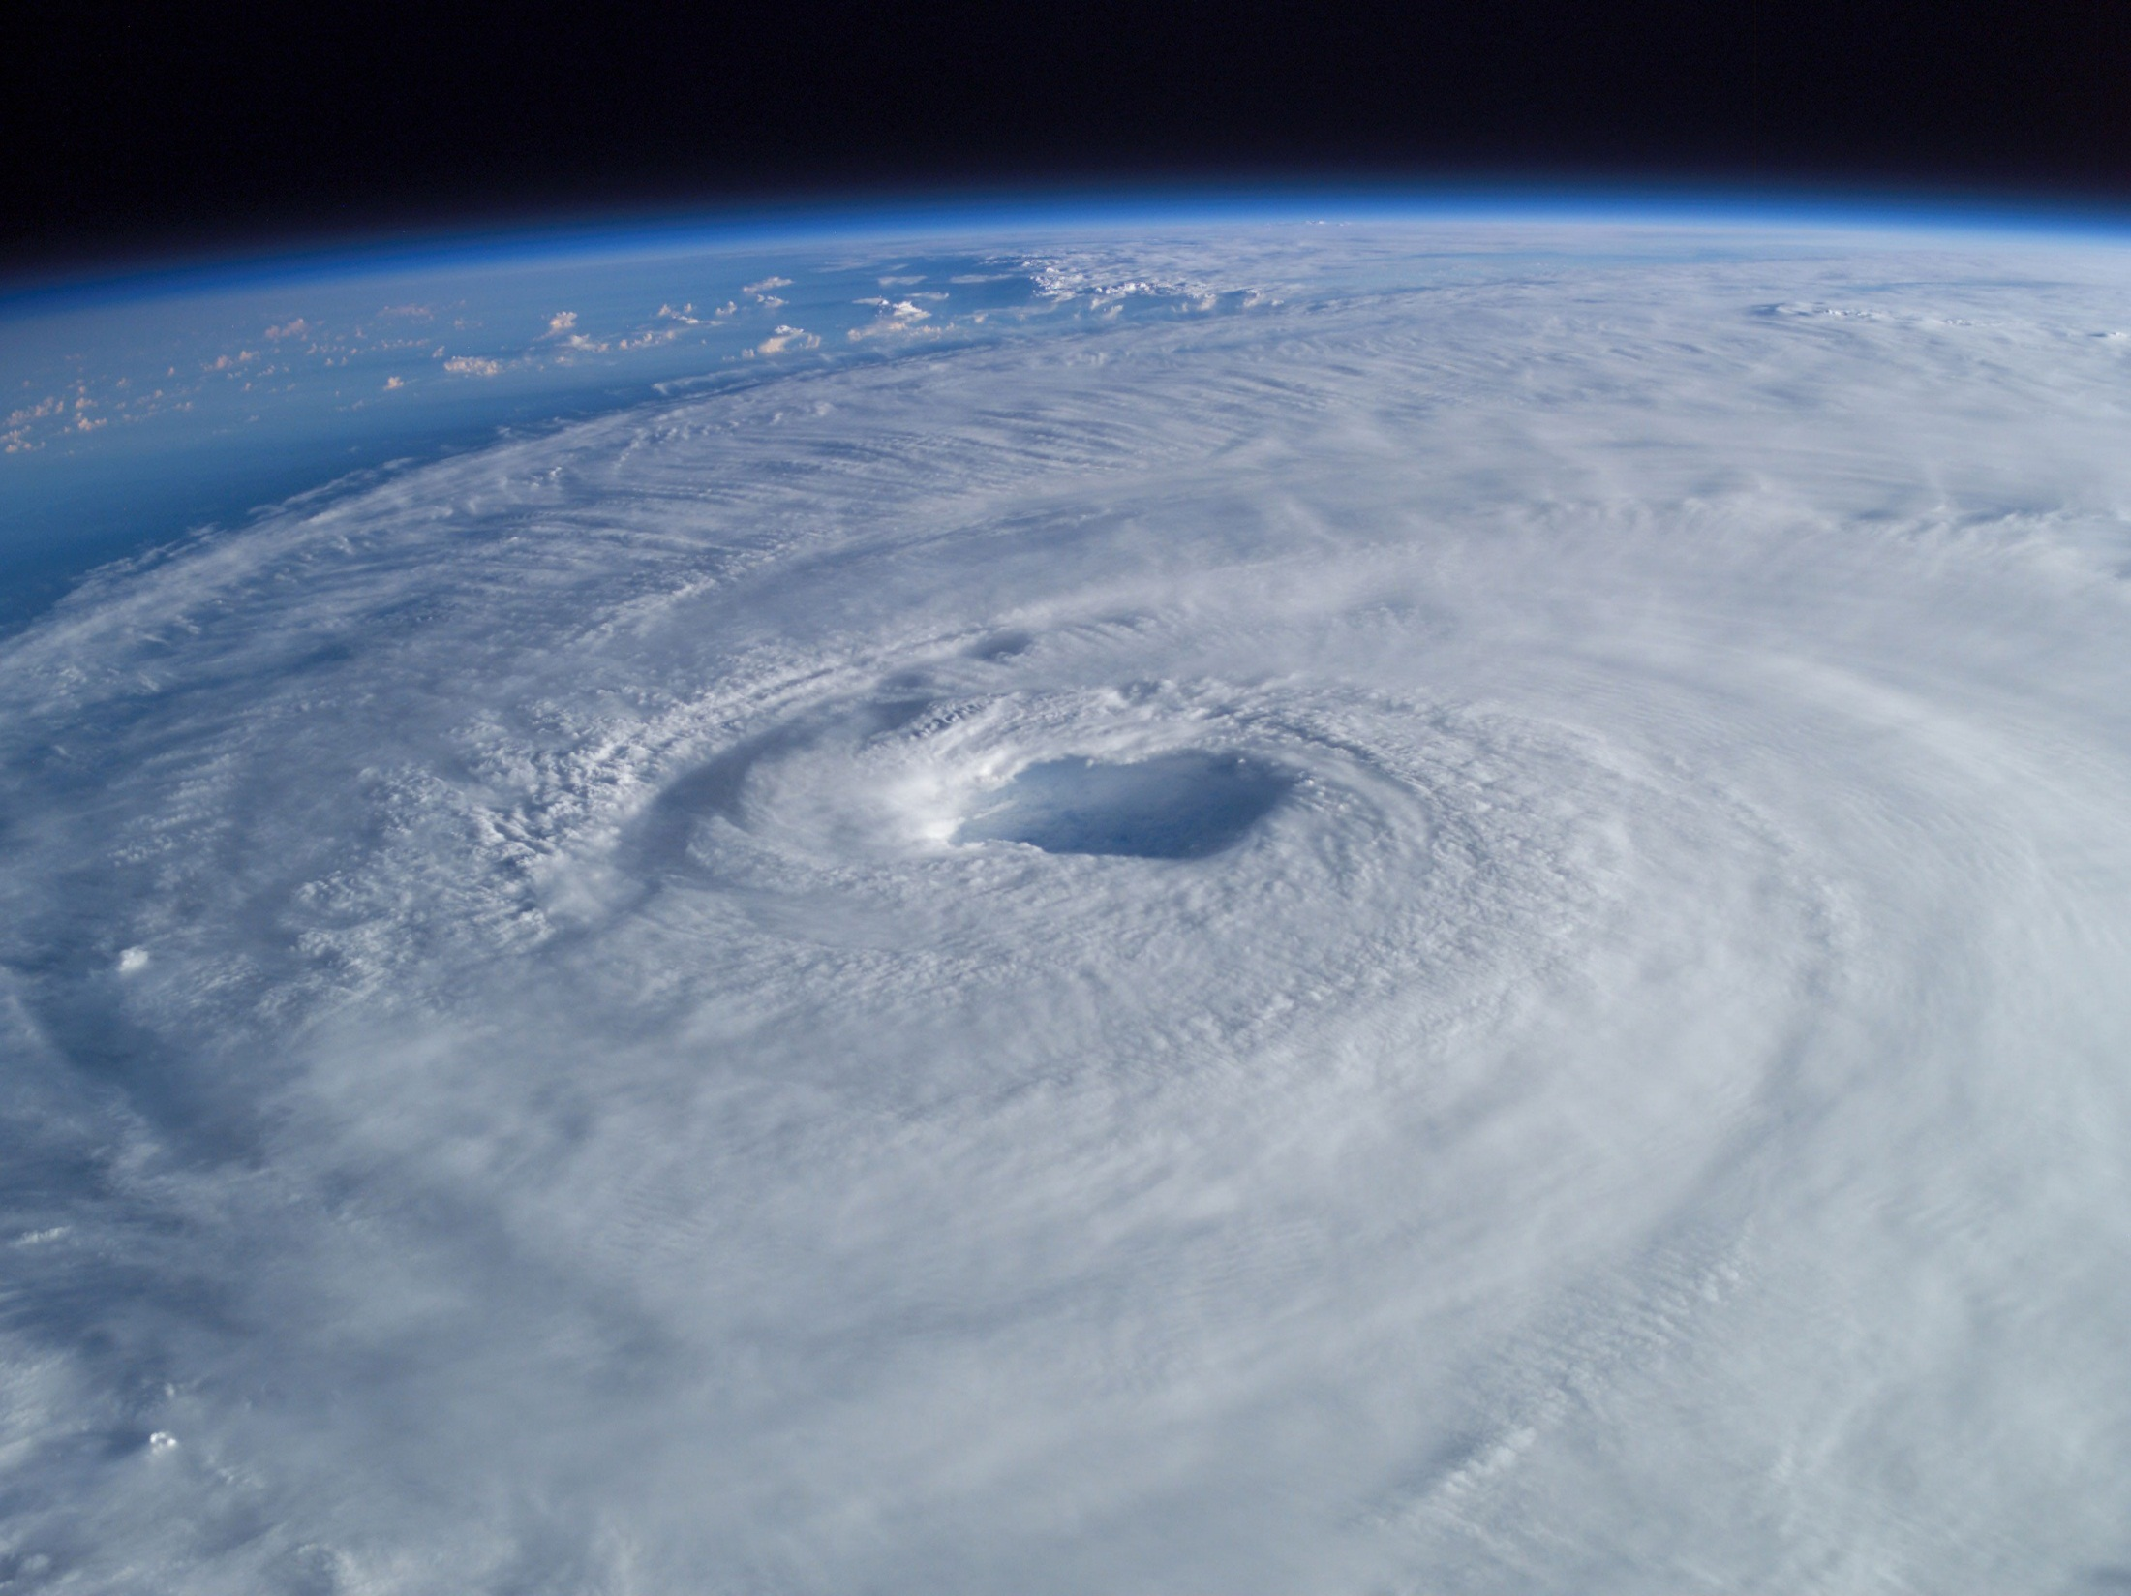

Slide 10
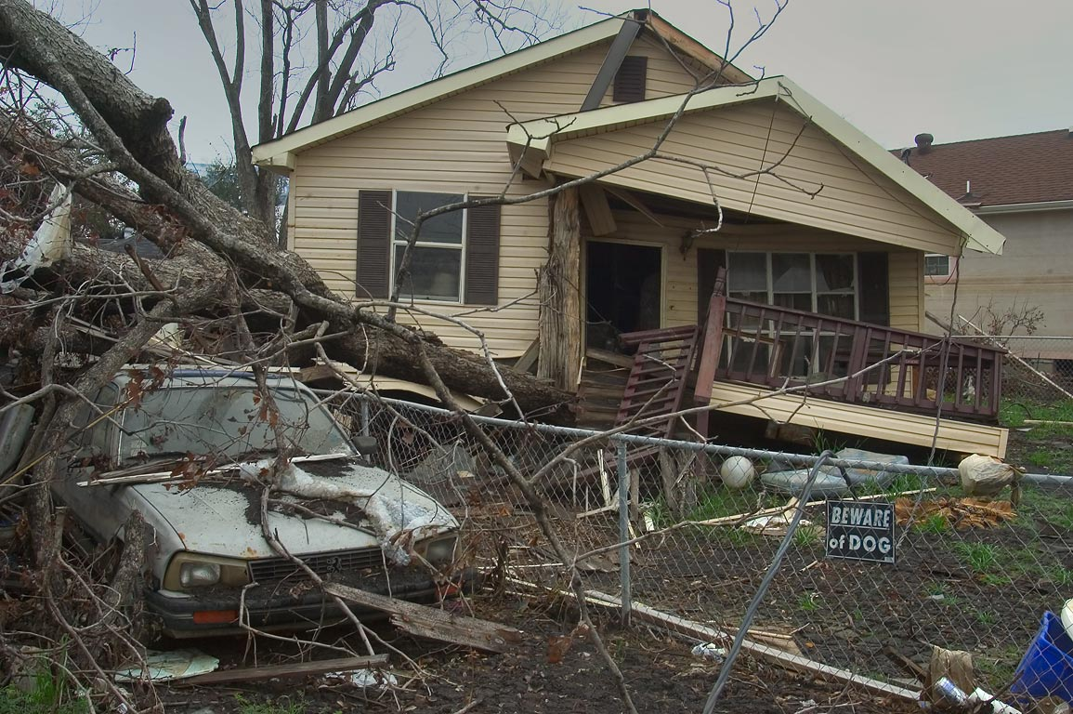
http://video.nationalgeographic.com/video/101-videos/hurricanes-101

Slide 11
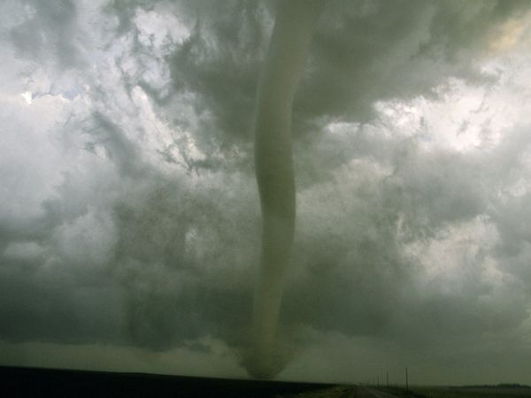
Tornadoes
What is a tornado?
A tornado is a whirling, violent windstorm accompanied by a funnel cloud that travels a narrow path over land.
They can destroy large buildings, uproot trees and throw vehicles hundreds of yards. They can also drive straw into trees. In an average year, 1,000 tornadoes are reported nationwide.

Slide 12
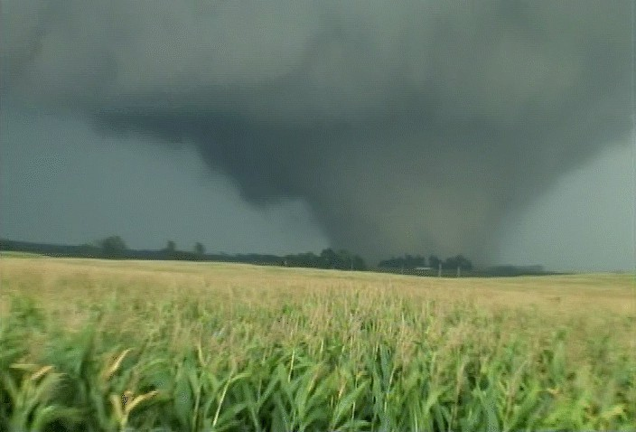

Slide 13
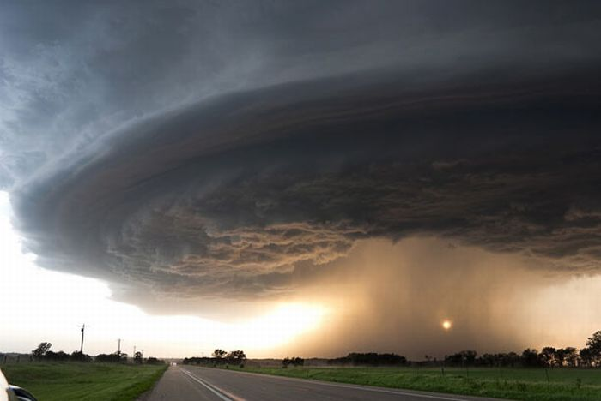

Slide 14
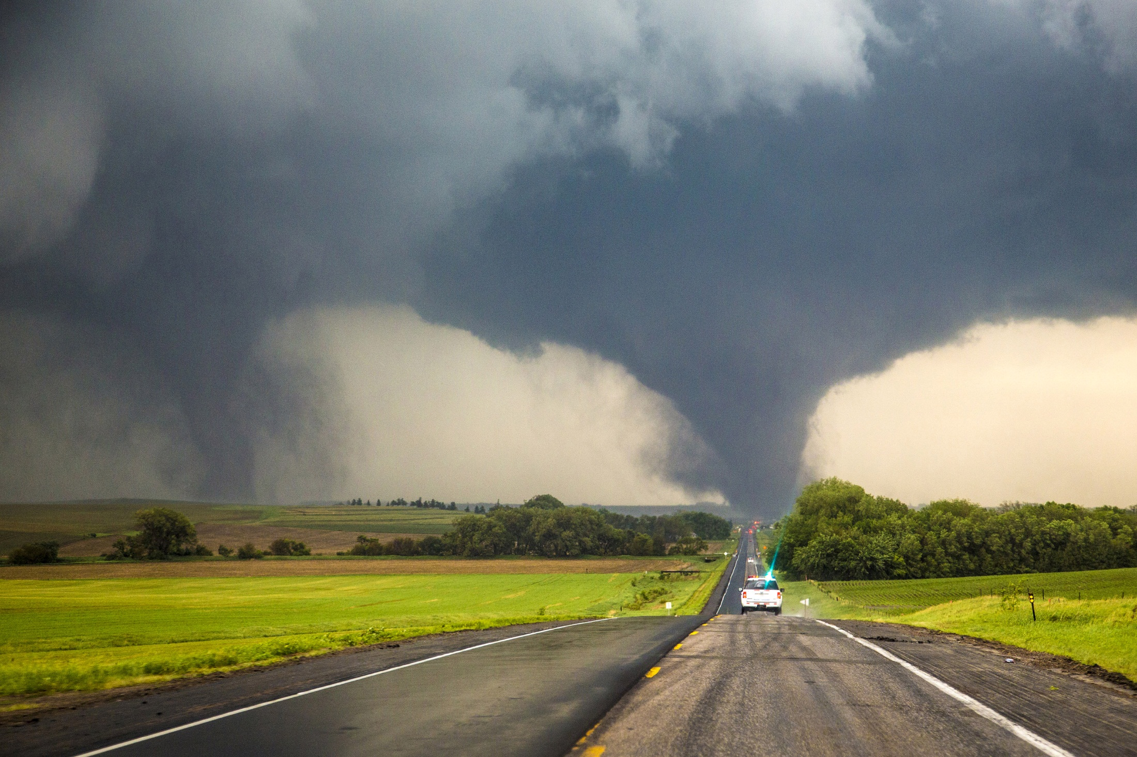

Slide 15
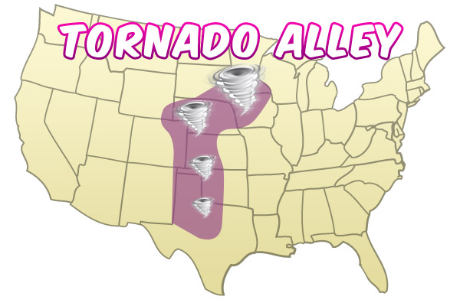

Slide 16
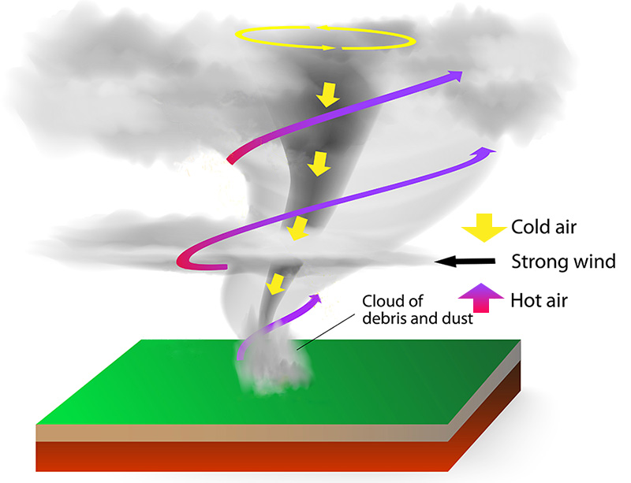

Slide 17
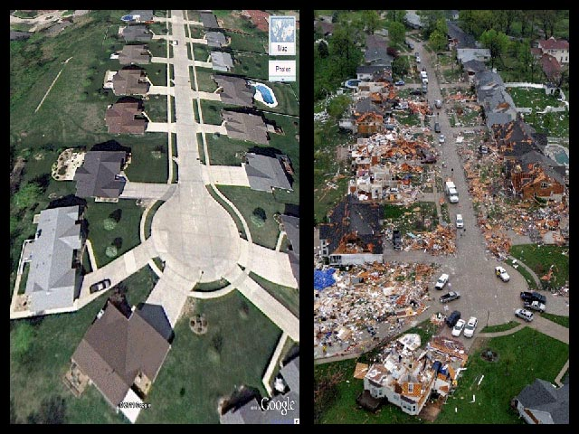
before
after

Slide 18
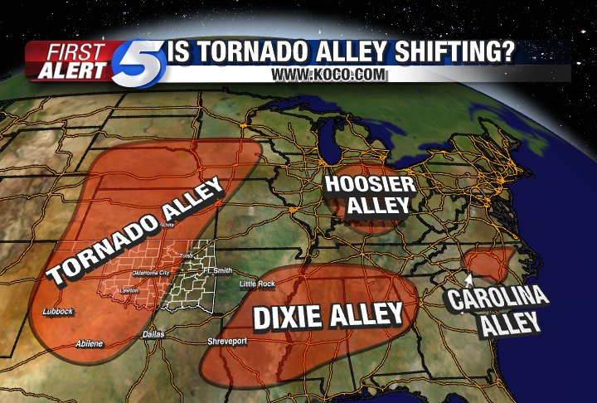
http://video.nationalgeographic.com/video/kids/forces-of-nature-kids/tornadoes-101-kids/Video

Slide 19
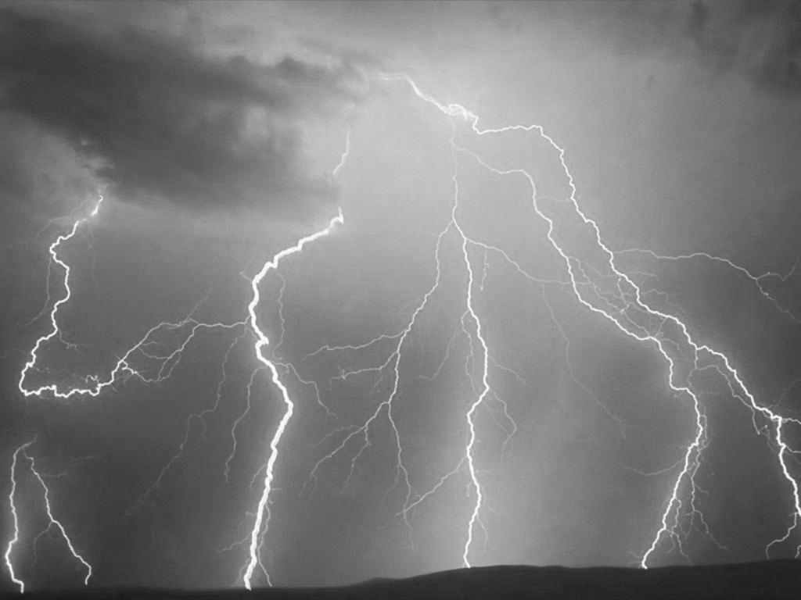
Thunder & Lightning Storms
Lightning is a bright flash of electricity produced by a thunderstorm. All thunderstorms produce lightning and are very dangerous. Thunder is caused by lightning. When a lightning bolt travels from the cloud to the ground it actually opens up a little hole in the air, called a channel. Once the light is gone the air collapses back in and creates a sound wave that we hear as thunder. The reason we see lightning before we hear thunder is because light travels faster than sound!

Slide 20
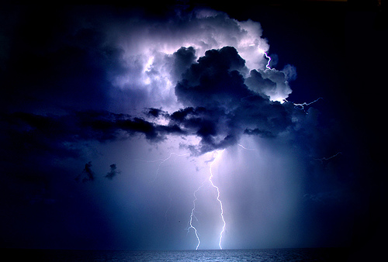
before
after

Slide 21
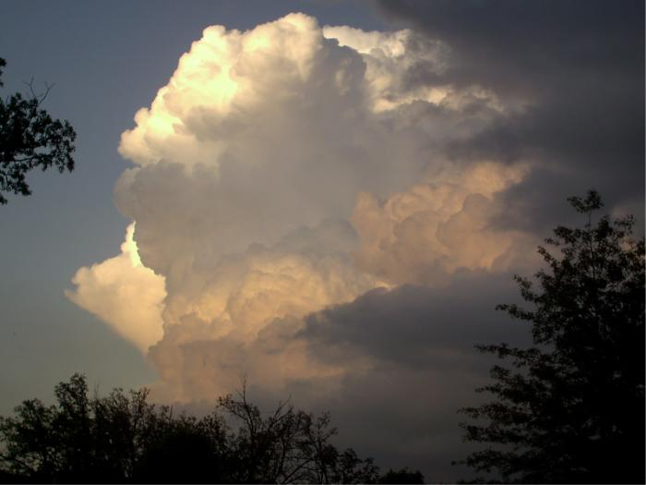
before
after

Slide 22
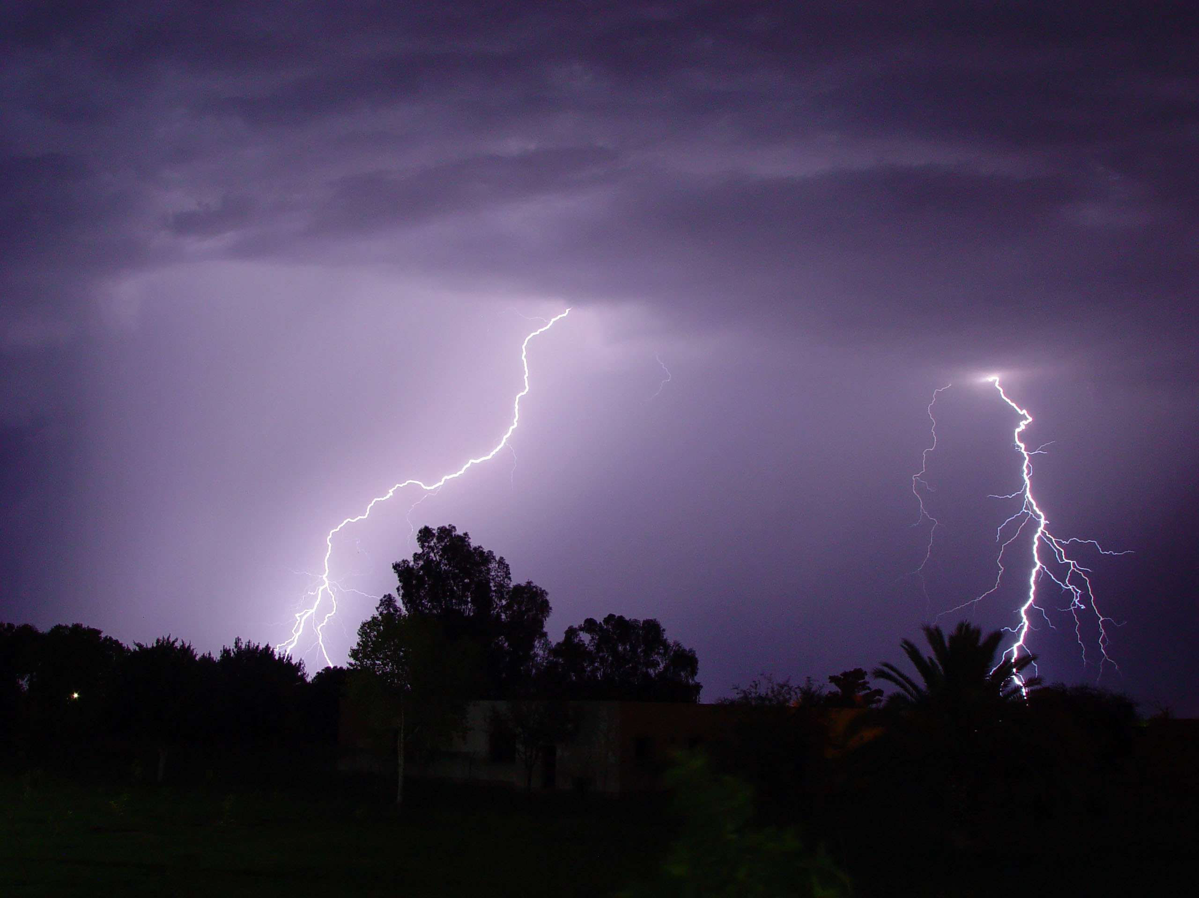

Slide 23
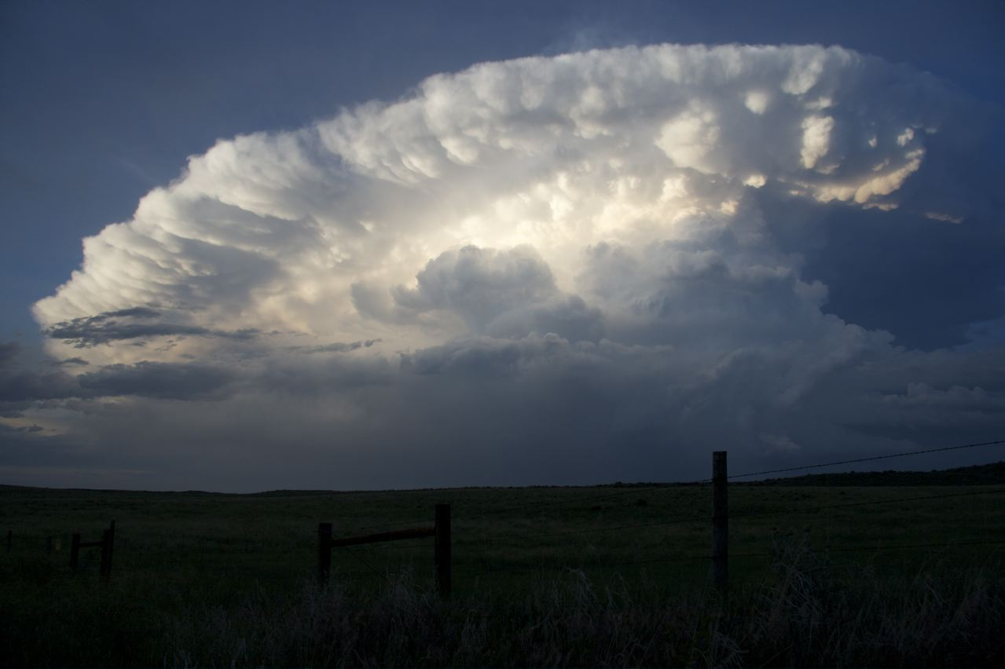

Slide 24
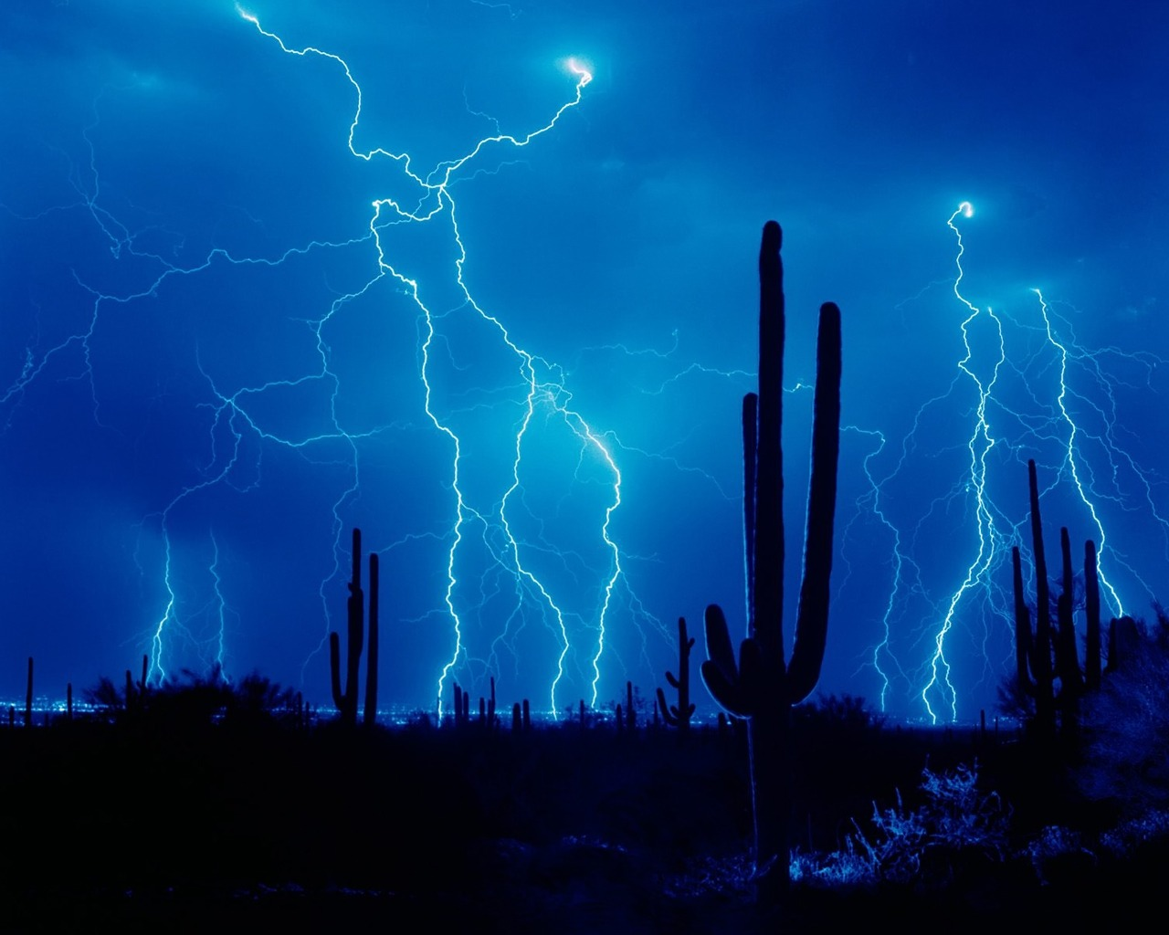

Slide 25
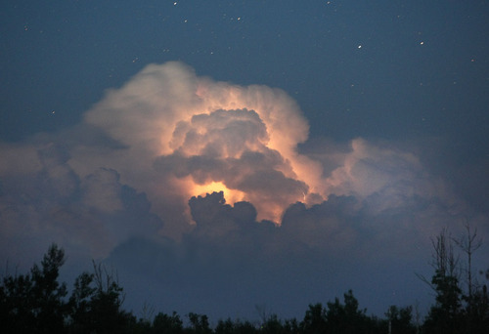
before
after
http://video.nationalgeographic.com/video/kids/forces-of-nature-kids/lightning-101-kids/

Slide 26
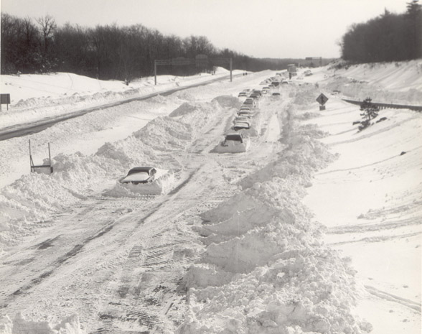
Blizzards
A blizzard is snowstorm that lasts more than 3 hours with winds blowing at 35 miles per hour or higher. One of the reasons why blizzards are so dangerous is the reduced visibility due to snow flying everywhere from the fast wind.

Slide 27
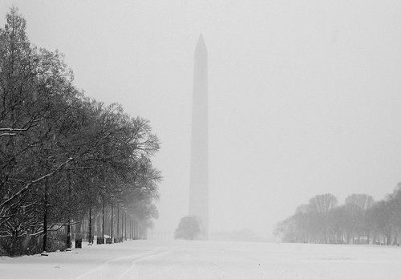
before
after

Slide 28
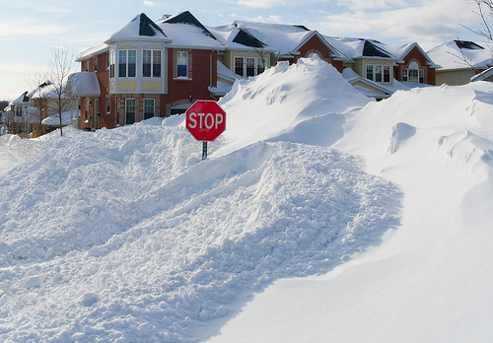
before
after

Slide 29
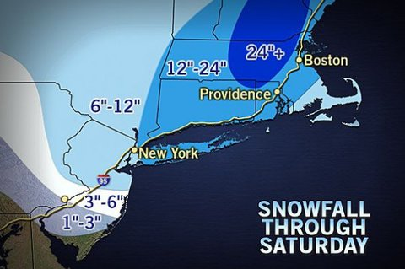

Slide 30
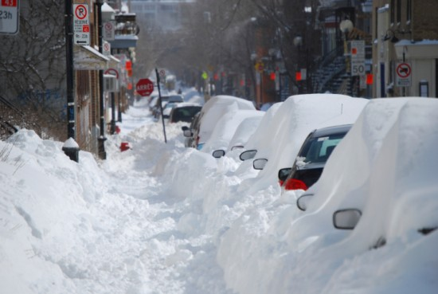

Slide 31
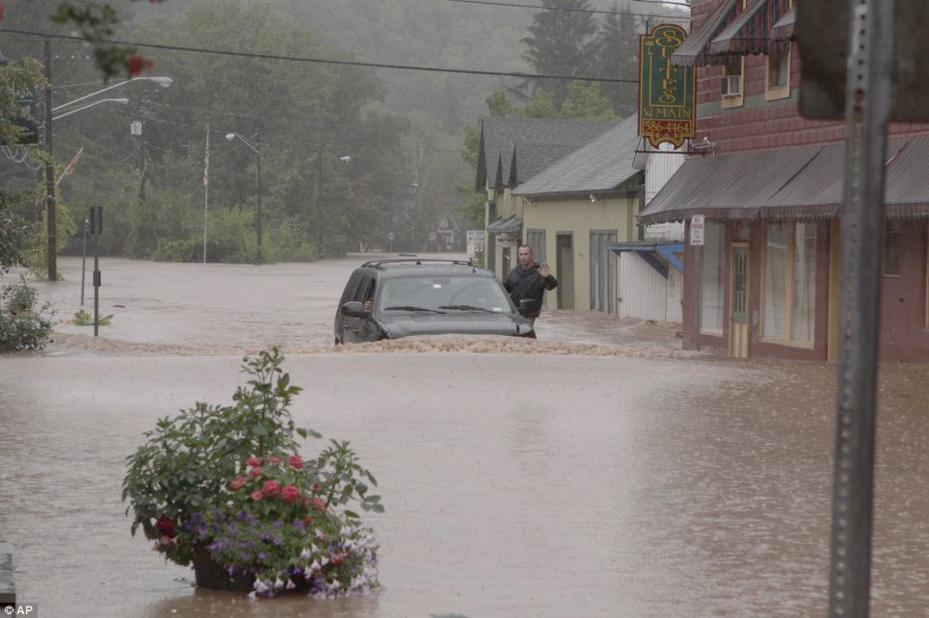
Floods
A flood results from days of heavy rain and/or melting snows, when rivers rise and go over their banks. Flash floods are the #1 weather-related killer in the U.S. Nearly 80% of flash flood deaths are auto related.

Slide 32
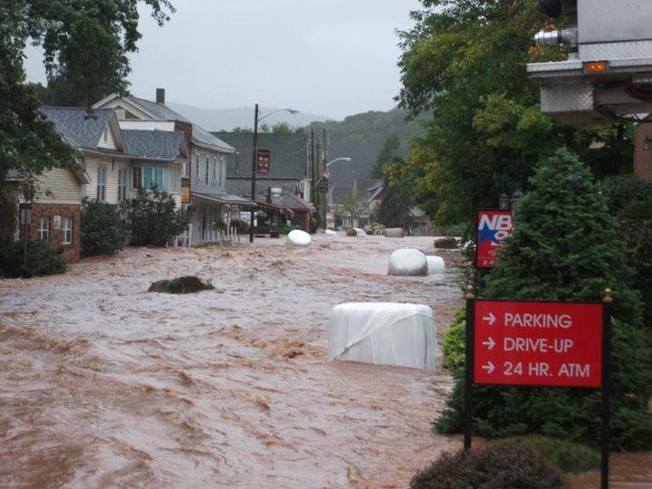
before
after

Slide 33
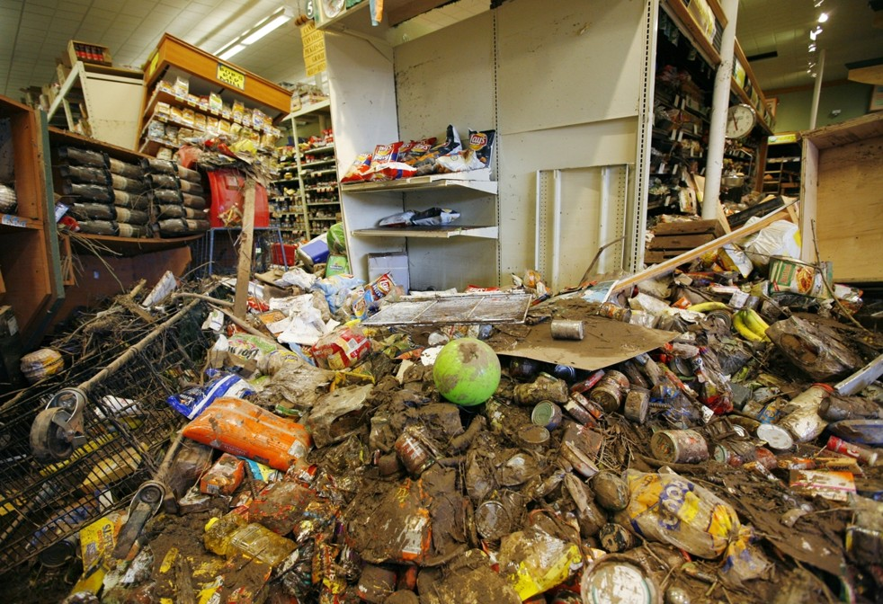
before
after

Slide 34
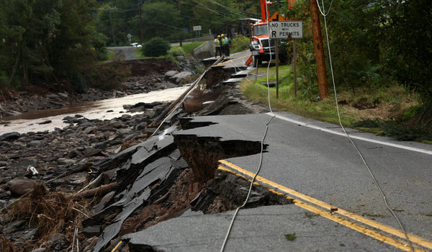
before
after

Slide 35
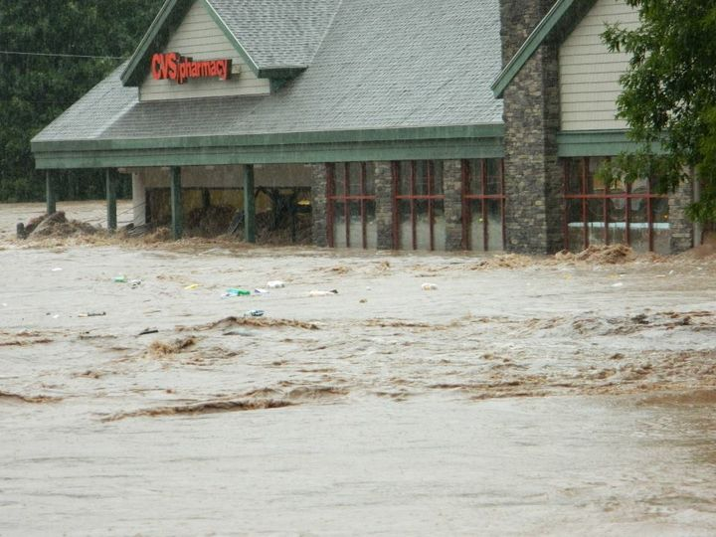
before
after

Slide 36
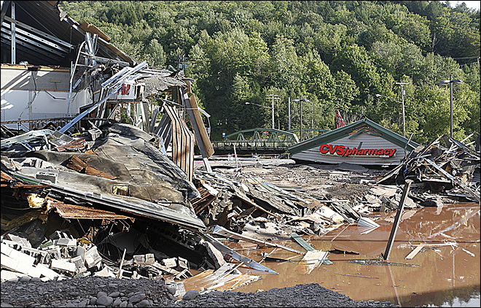
before
after

Slide 37
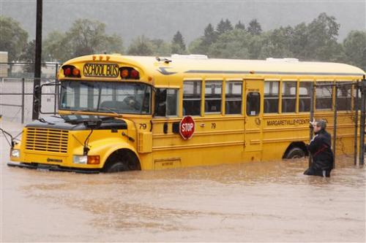
before
after
Margaretville Flood 2011

Slide 38
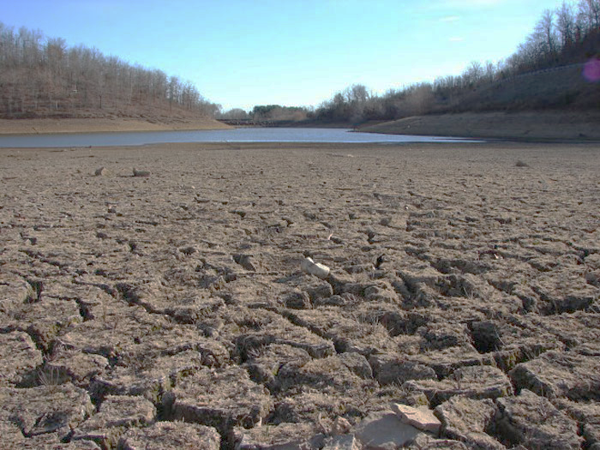
Droughts
When a place is in a drought, it is dry and hot, often dusty; cracks may appear in the soil, and rivers, lakes, streams, and other sources of water can go dry. A drought means that a place has less precipitation (rain or snow) than normal over a few months or even longer. Drought has many causes. It can be caused by not receiving rain or snow over a period of time.

Slide 39
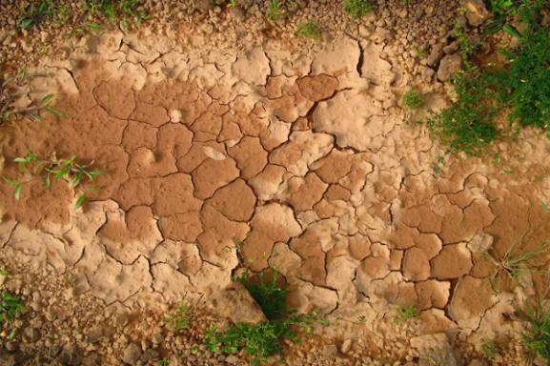
before
after

Slide 40
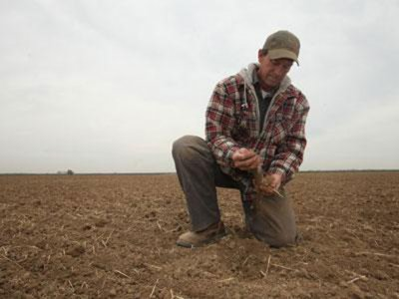
before
after

Slide 41
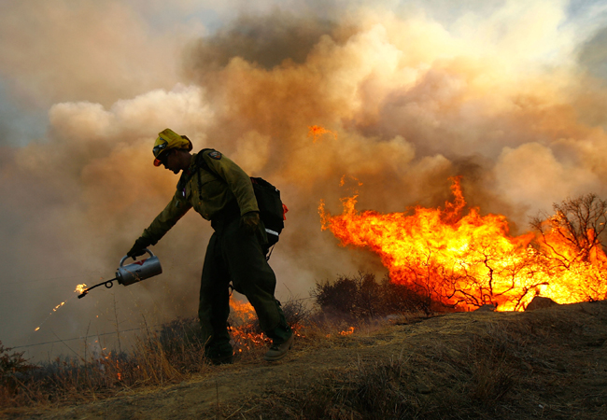
before
after

